Slide 1
Shared Prosperity:
Leveling the Playing Field through
Inclusive Upskilling, Innovation, & Entrepreneurship
Jeana Wirtenberg, Ph.D.
Associate Professor of Professional Practice &
Associate Director, Rutgers Institute for Corporate Social Innovation
November 4, 2022

Slide 2
Context: Inclusive Impact Summit &
Shared Prosperity
The Wealth Chasm and Racial Wealth Gap
Agenda
Core Sustainability Concepts
Inclusive Upskilling, Innovation & Entrepreneurship
Speaker Panel Discussion

Slide 3
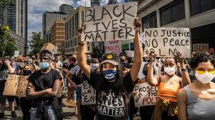
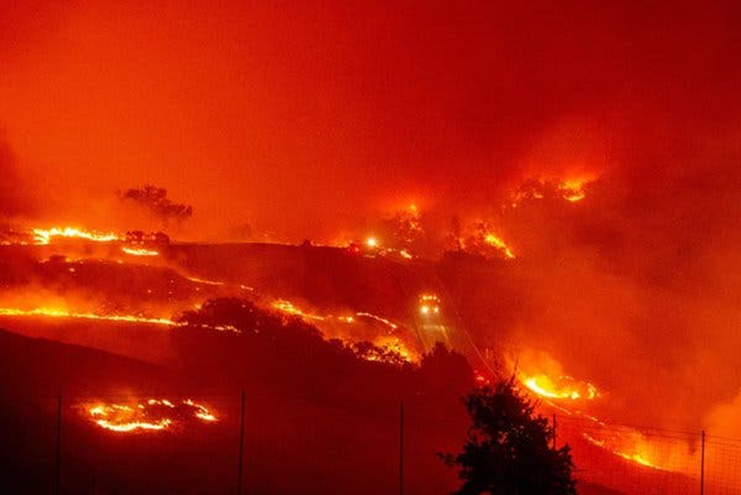
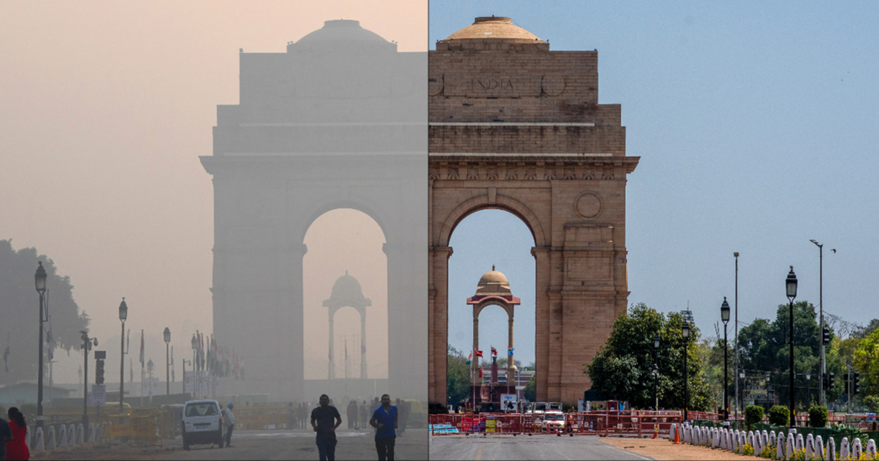
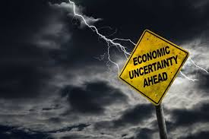
Context
We are living through unprecedented times in history. “Normal” will never be the same.
“The sustainability revolution will be organic. It will arise from the visions, insights, experiments and actions of billions of people. The burden of making it happen is not on the shoulders of any one person or group. No one will get the credit, but everyone can contribute.”
Donnella Meadows
Notes:
One catastrophic event can skew everything.
Pandemic
Megacyclones
Fire Maelstroms
Severe long-term droughts
Wars
In 2020, we have all of these around the globe all at once.

Slide 4
Obscene Wealth Chasm - 2016
The richest 62 people in the world own the same as the bottom 50% of the world.
The 62 billionaires own $1.76 trillion, which is the cumulative wealth of the bottom 3.5 billion of the world’s population.
The wealth of the richest 62 people has risen by 44% since 2010, while the wealth of the poorest 3.5 billion fell 41%.
Oxfam Briefing Paper, “An Economy for the 1%,” January 2016.
Notes:
Wealth inequalities have increased at the very top of the distribution. Global multimillionaires have captured a disproportionate share of global wealth growth over the past several decades. The top 1% took 38% of all additional wealth accumulated since the mid-1990s, whereas the bottom 50% captured just 2% of it. This inequity xstems from serious inequiality in grrowth rates between the top and the bottom segments of the wealth distriution. (World Inequality Report 2022, p. 12. And 2020 marked the steepest increase in global billionaires’ share of wealth on record.

Slide 5
How U.S. Wealth Was Concentrated in 2019
Federal Reserve Bank of St. Louis, “Has Wealth Inequality in America Changed Over Time?,” December 2020

Slide 6
https://www.cct.org/stories/partnering-for-shared-prosperity-in-an-equitable-vibrant-chicago/
Notes:
The US is a country of tremendous economic opportunity. However, that opportunity isn’t shared equally. Currently, long-standing wealth gaps across race, gender, and class are widening., fueled by evolving technologies, shifting labor markets, changing demographics, and continued racial bias.
In the US., incomes among the wealthiest families increased roughly 90 percent from 1963 to 20016, as copared to an increase of less than 10 percent for the national’s families with the least wealth during this same period. The result is a steadily widening gap between lower- and higher-income individuals and families that limits our ability to succeed as a nation. A growing share of America’s population is being left behind, especially people of color.
The labor market generates considerable opportunity for the people and places already equipped for success in the digital era while simultameously creating new barriers to economic opportunity for women, people of color, and other underrepresented populations, as well as geographies struggling to compete.
While individual cities face their own unique challenges and opportunities, they are united by a lack of inclusive economic growth. Even in economically healthy cities, stark racial disparities persist, and lower income families face growing displacement pressures. In response, in cities across America, a diverse range of organizatoins and leaders are working to build what we call shared prosperity. Cities are leveraging this trust to forge new partnerships across sectors, apply technology to improve civic engagement and reform policies and practices to strenghten job quality. While the speciifc approach of each city is unique, there are three commo principles that underlie strategies to ensure shared prosperity in cities: (see p. 4)

Slide 7
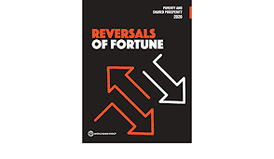
Reversals of Fortune
COVID-19, Conflict, and Climate Change have reversed the gains in poverty eradication for the first time in a generation.
Conflict
COVID-19
Climate Change
https://openknowledge.worldbank.org/bitstream/handle/10986/34496/9781464816024.pdf?sequence=33&isAllowed=y
Notes:
The World Bank report said that “it is the quality of schooling that is key to poverty reduction for both non-poor and poor students in rural and urban areas alike (p.11).
I also thought it was very interesting that they pointed out:
“Although the pandemic has different impacts on different social groups, the fact that all are affected is an opportunity for leaders to promote a sense of social inclusion and collective resolve, the benefits of which could extend beyond the crisis.”
They want on to say…
“Reversing even a massive reversal of fortune, such as what we are seeing now it possible. It has been done many times in the past, in the face of what were regarded at the time as insurmountable challenges – for exaple, eradicating smallbox, ending WWII, closing the ozone hole, and it will be done again in the future.
This global crisis is a defining historical moment. The world needs to commit to cooperation and coordination both within and between countries. We must commit to working together, and to working better, for the long term.”

Slide 8
“Shared prosperity focuses on the poorest 40 percent of the population…defined as the annualized growth rate of their mean Household per capita consumption or income. The shared prosperity Premium is the difference between the growth of the poorest 40 percent and the entire population.”
“Shared prosperity and the shared prosperity premium are important indicators of inclusion and well-being in any economy and correlate with reductions in poverty and inequality.”
Source:
The World Bank (March 2021). Shared Prosperity: Monitoring Inclusive Growth.
_______________________________________________________
A similar (but not identical) objective appears as goal 10.1 in the UN Sustainable Development Goals:
“By 2030, progressively achieve and sustain income growth of the bottom 40 percent of the population at a rate higher than the national average.”
How is
“Shared Prosperity” defined?
Notes:
The expression “shared prosperity” has recently gained prominence as a development objective, a social goal that should be pursued by all nations in the world. It has been adopted as one of two central objectives that are meant to guide everything the World Bank does, and a very closely associated objective is listed as goal 10.1 of the UN Sustainable Development Goals.

Slide 9
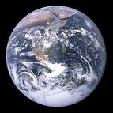
Core Sustainability Concepts
Systems thinking
Socio-economic
justice
Intergenerational responsibility
Enough … … for all … … forever.
Notes:
Dr. Charles Hopkins, “Enough For All Forever,“ Education Canada, Vol 49 (4), 2009. Dr. Hopkins is the UNESCO Chair on Reorienting Teacher Education to Address Sustainability. He attributes the “enough for all forever” phrase to an unnamed African elder who used the phrase when asked to define “sustainable development,” at a UN conference they both attended.

Slide 10
Inclusive innovation is the idea that the visionaries, inventors, entrepreneurs and gatekeepers of innovation should be as diverse as our nation.
3 Reasons:
Social Justice Imperative
National Competitiveness
Diverse Teams = Better Innovations
-Jeffrey A. Robinson, Rutgers Professor & Provost
What is Inclusive Innovation?

Slide 11
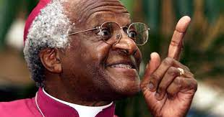
Ubuntu translates as "I am because we are" or "the belief in a universal bond of sharing that connects all humanity."
Today, many associate Ubuntu with interconnection. "My humanity is closely bound up with yours," as Archbishop Desmond Tutu stated.
It serves as a reminder that no one is an island and that everything you do, good or bad, has an influence on your family, friends, and society. It also urges us to reconsider our actions and the impact they may have on others.
Desmond Tutu on Ubuntu and interconnection

Slide 12
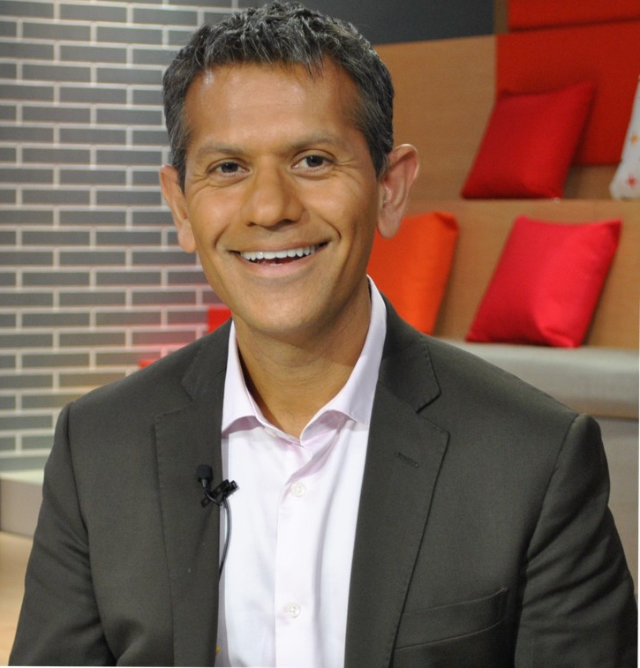
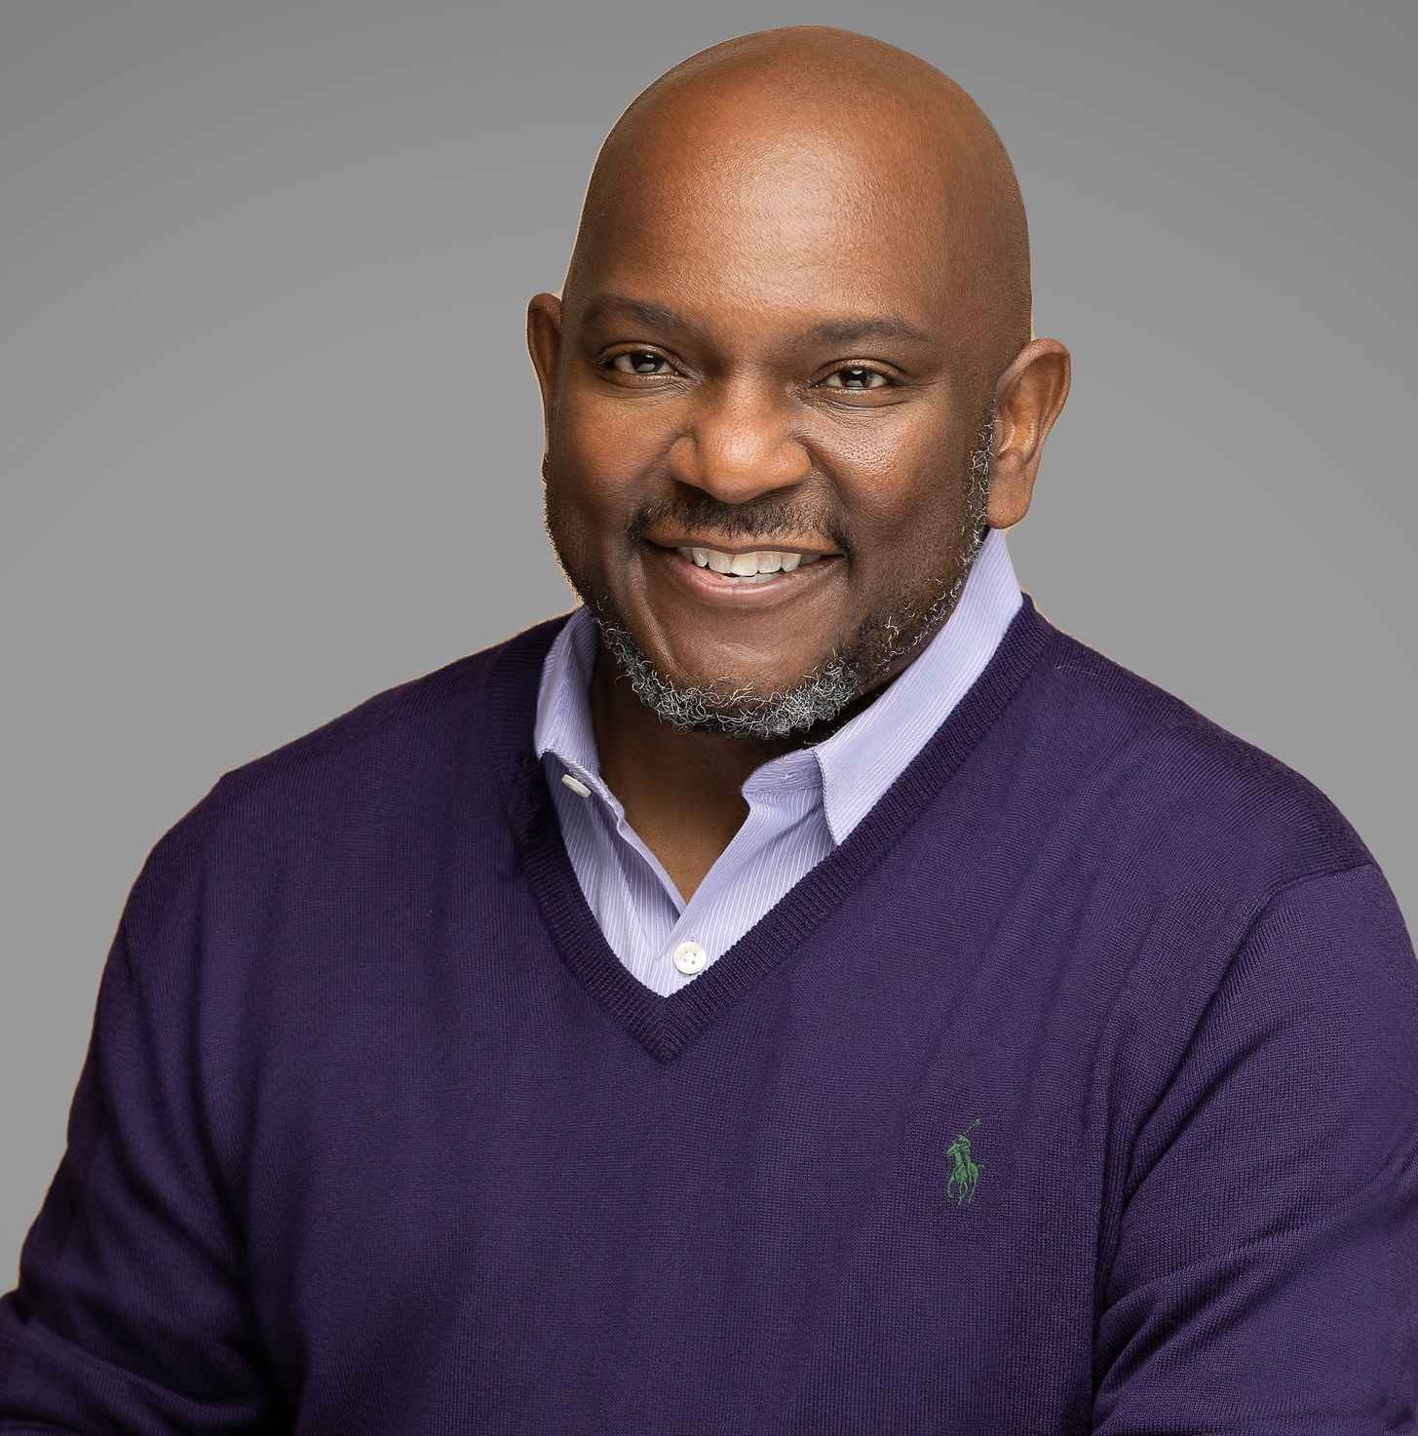
Our Speakers
Bhushan is a global practice leader, pragmatic strategist and practitioner with a demonstrable track record of working with financial Institutions and leading global organizations to design and implement integrated business and workforce strategies that enable sustainable business, customer, financial and regulatory outcomes. He also serves as an Adjunct Professor for NYU Stern School of Business, where he teaches the consulting practice course to MBA students.
Lyneir Richardson is the Executive Director of the Center for Urban Entrepreneurship and
Economic Development (CUEED) at Rutgers University in Newark, NJ, where he leads
capacity-building programs that have assisted 600+ N.J. entrepreneurs and founded the Black
and Latino Investment Fund. He is also Assistant Professor of Professional Practice in the
Department of Management and Global Business at Rutgers Business School. Lyneir was recently named a nonresident senior fellow with Brookings Institution.

Slide 13
Thank You

